Slide 1
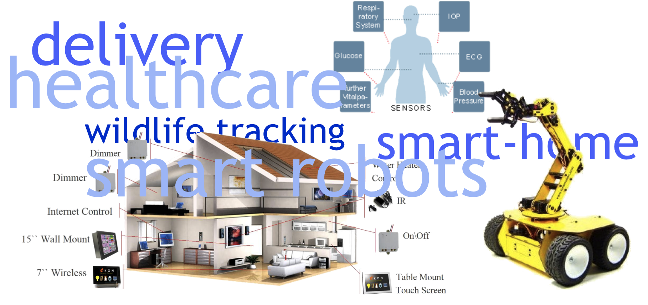
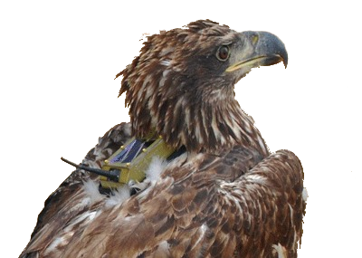
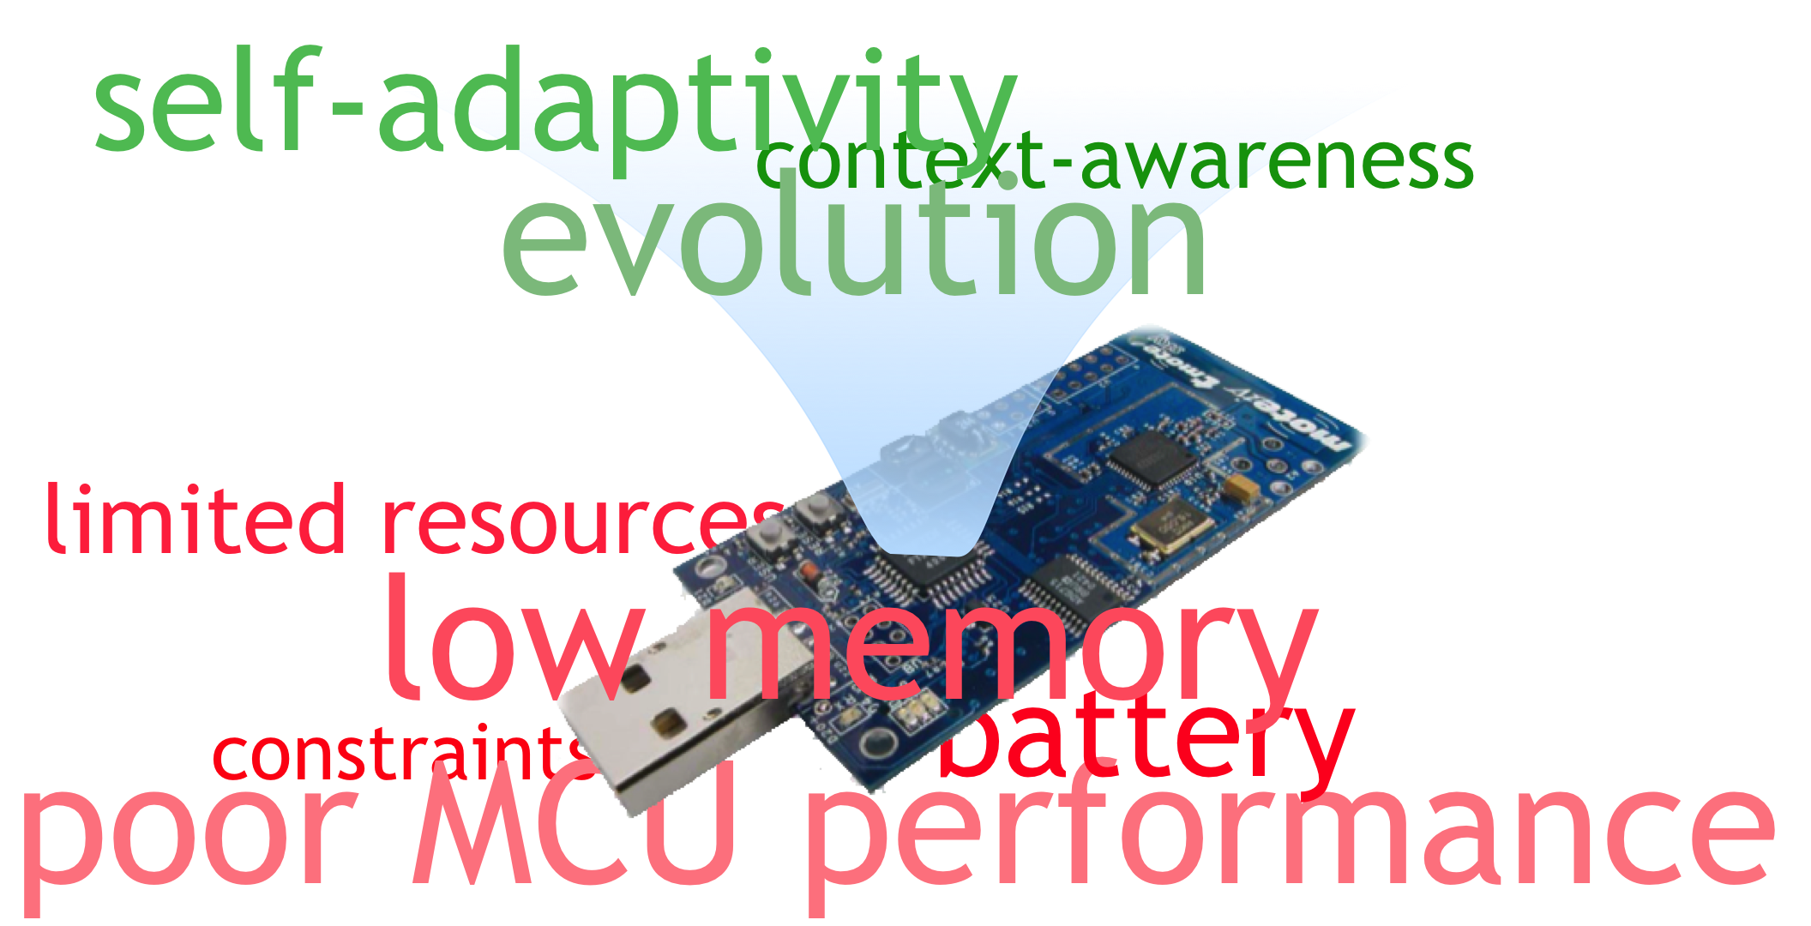
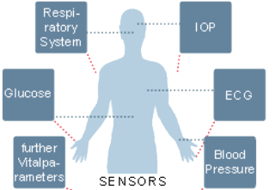
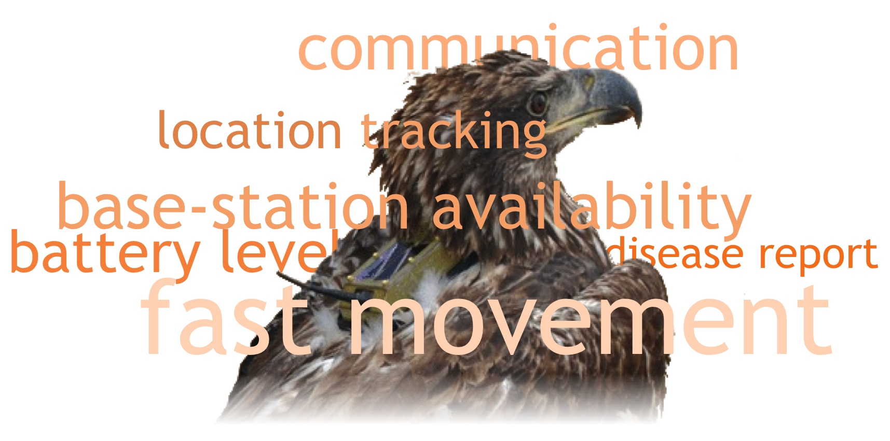
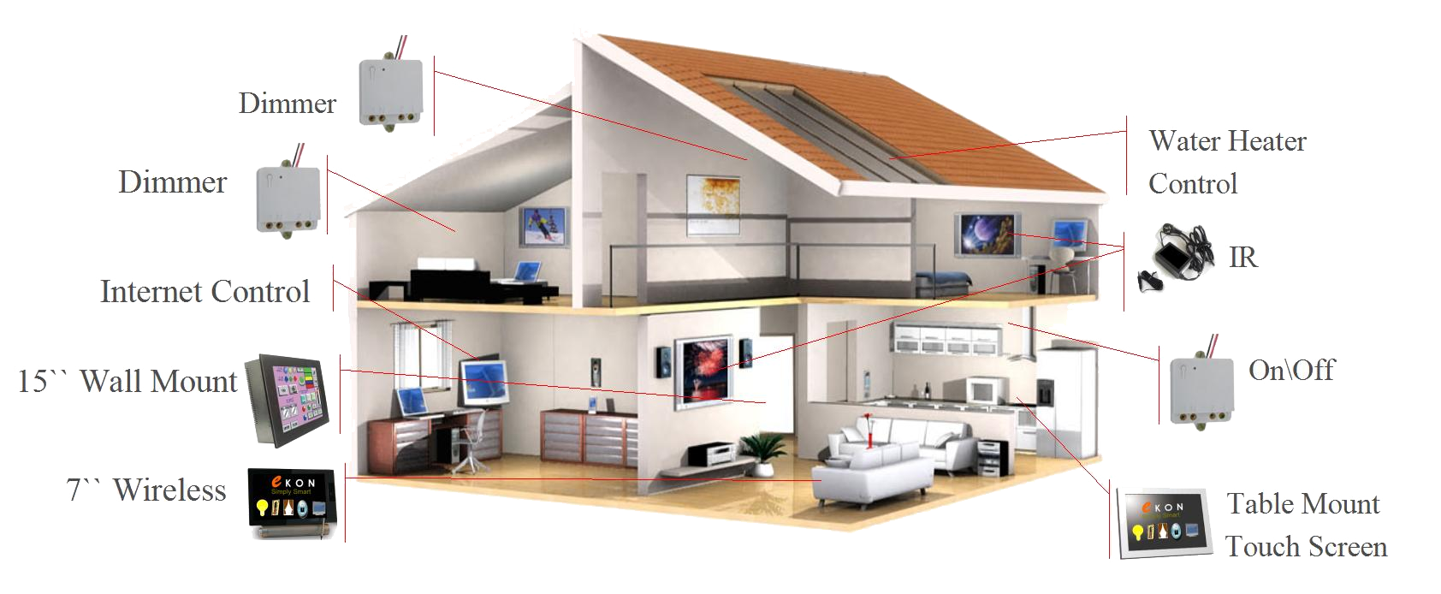
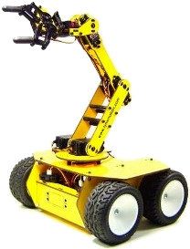
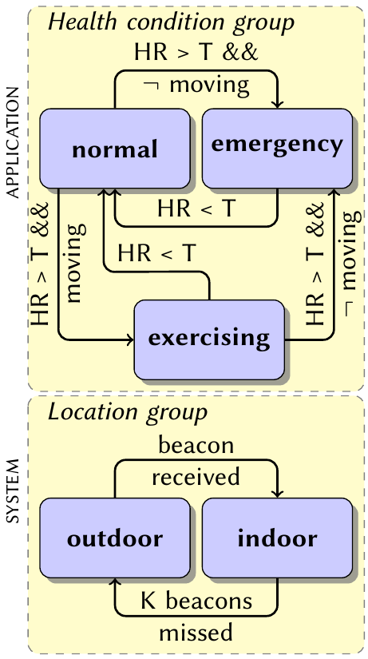
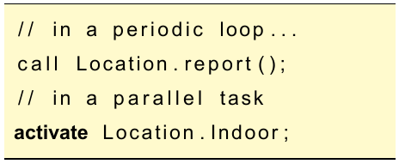
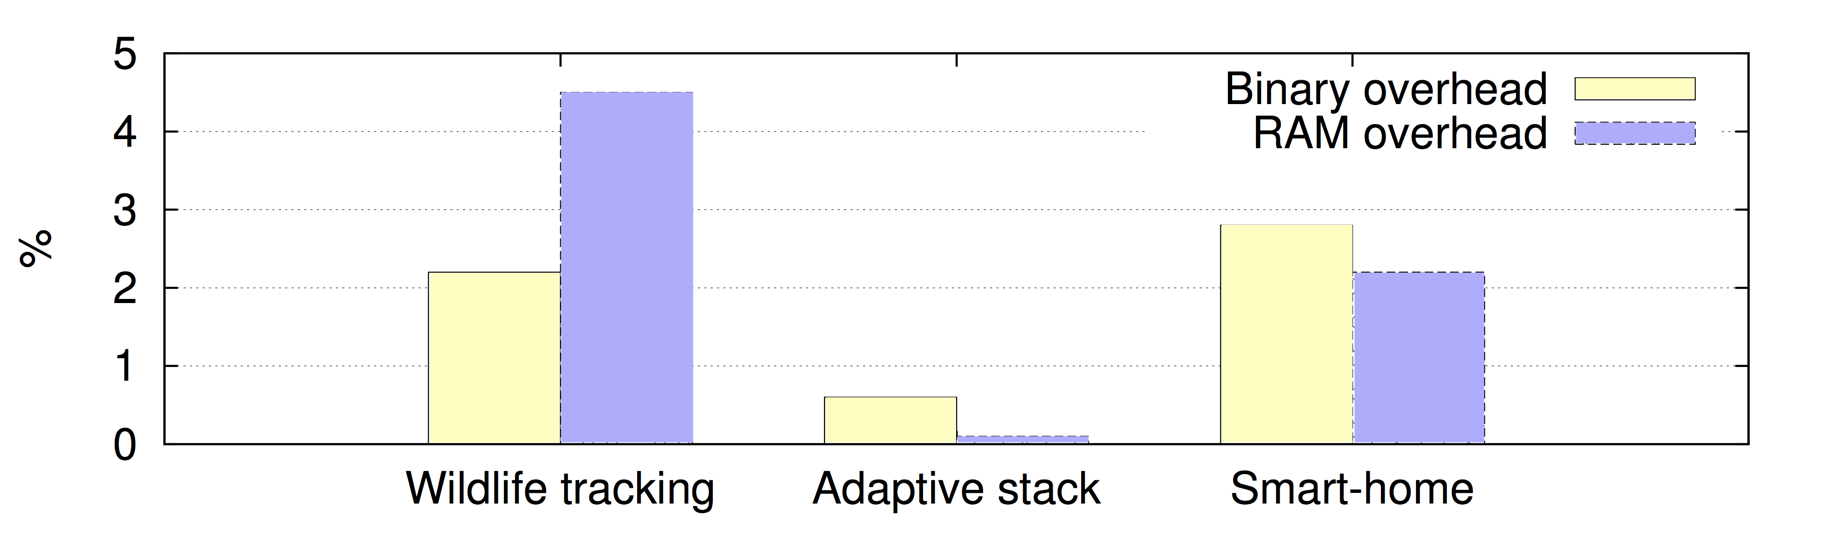
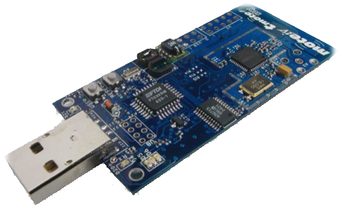
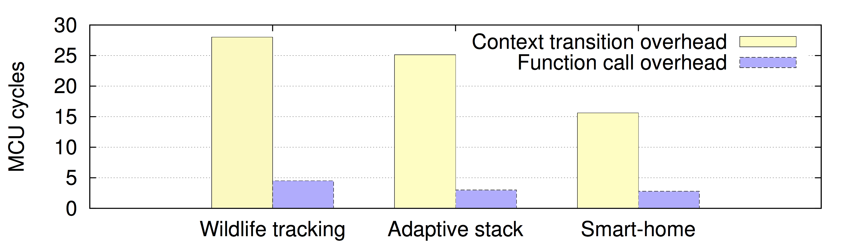
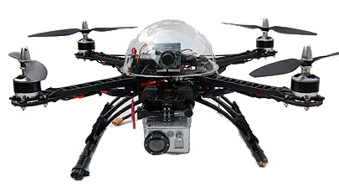
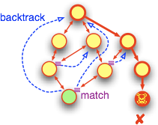


Towards Self-adaptive Software for Resource-constrained Cyberphysical Systems
Mikhail Afanasov⋆, Luca Mottola⋆†, Carlo Ghezzi⋆
⋆Politecnico di Milano (Italy), †Swedish Institute of Computer Science (SICS)
Contact email: afanasov@elet.polimi.it
Context-Oriented Programming for Cyberphysical Systems (CPSs)
CPSs need to be adaptable due to environmental dynamics
Context is a representation of the environment
Context-Oriented programming provides language abstractions for adaptation
Context-Oriented programming is using context as a building block
communication
location tracking
base-station availability
battery level
disease report
fast movement
delivery
Example: Wildlife Tracking
healthcare
Should send location data and health conditions
Should transmit data if the base-station is in the reach
Should locally log data in infrastructure-less situations
wildlife tracking
smart-home
smart robots
Context-Oriented nesC (ConesC)
Mapping
Example
triggers
call
EPIC
is error
context
provides
ConesC
source-code
components
TelosB
TRANSLATOR
nesC
source-code
MicaZ
activate
configuration
module
nesC TOOLCHAIN
Mulle
layered
Shimmer
interface
binary
Example
context group
is default
uses
command
NXTMOTE
IRIS
transitions
Imote2
check context
Applications are less complex
Overhead is negligible
self-adaptivity
context-awareness
indoor
call Indoor.report()
evolution
outdoor
call Outdoor.report()
Mapping
nesC
binary
limited resources
ConesC binary
only 2%
bigger
low memory
constraints
battery
7758 bytes vs 7640 bytes
poor MCU performance
Future Work
translator
Ongoing Work
Implementation of the translator
Evaluation on real applications
Domain-specific model-checking
Source-code generator
Context-Oriented programming for other CPS platforms
nesC sources
nesC toolchain
programming environment
binary
source-code generation
formal verification
archeological excavation
aerial drones
more details in Afanasov. M. et.al. “Context-Oriented Programming for Adaptive Wireless Sensor Network Software” DCOSS’14
IPSN14 – Berlin (Germany)
April 14th-17th

